Slide 1

Predicting the price of Apple Stock

Slide 2

Business Context
Recession
Predictive modelling to make informed decisions whether to buy, hold or sell

Slide 3

Business Question
Can investing small amount early helps to generate more wealth?
Can price of Apple stock be predicted to gain more profit?
Can risk be minimized by looking at the trends

Slide 4
Importance of Question
To Get insights
Generate wealth

Slide 5

Data Pipeline
DATA EXTRACTION
DATA PRE-PROCESSING
DATA ANALYSIS
MODEL BUILDING
MODEL SUMMARY
RECOMMENDATION& CONCLUSION

Slide 6
Data Extraction -API from y-finance
DATA
7 Features
Data from 1998-2023
Clean Data
Data Pre-Processing
-Standard Scaler

Slide 7



Exploratory Data Analysis

Slide 8
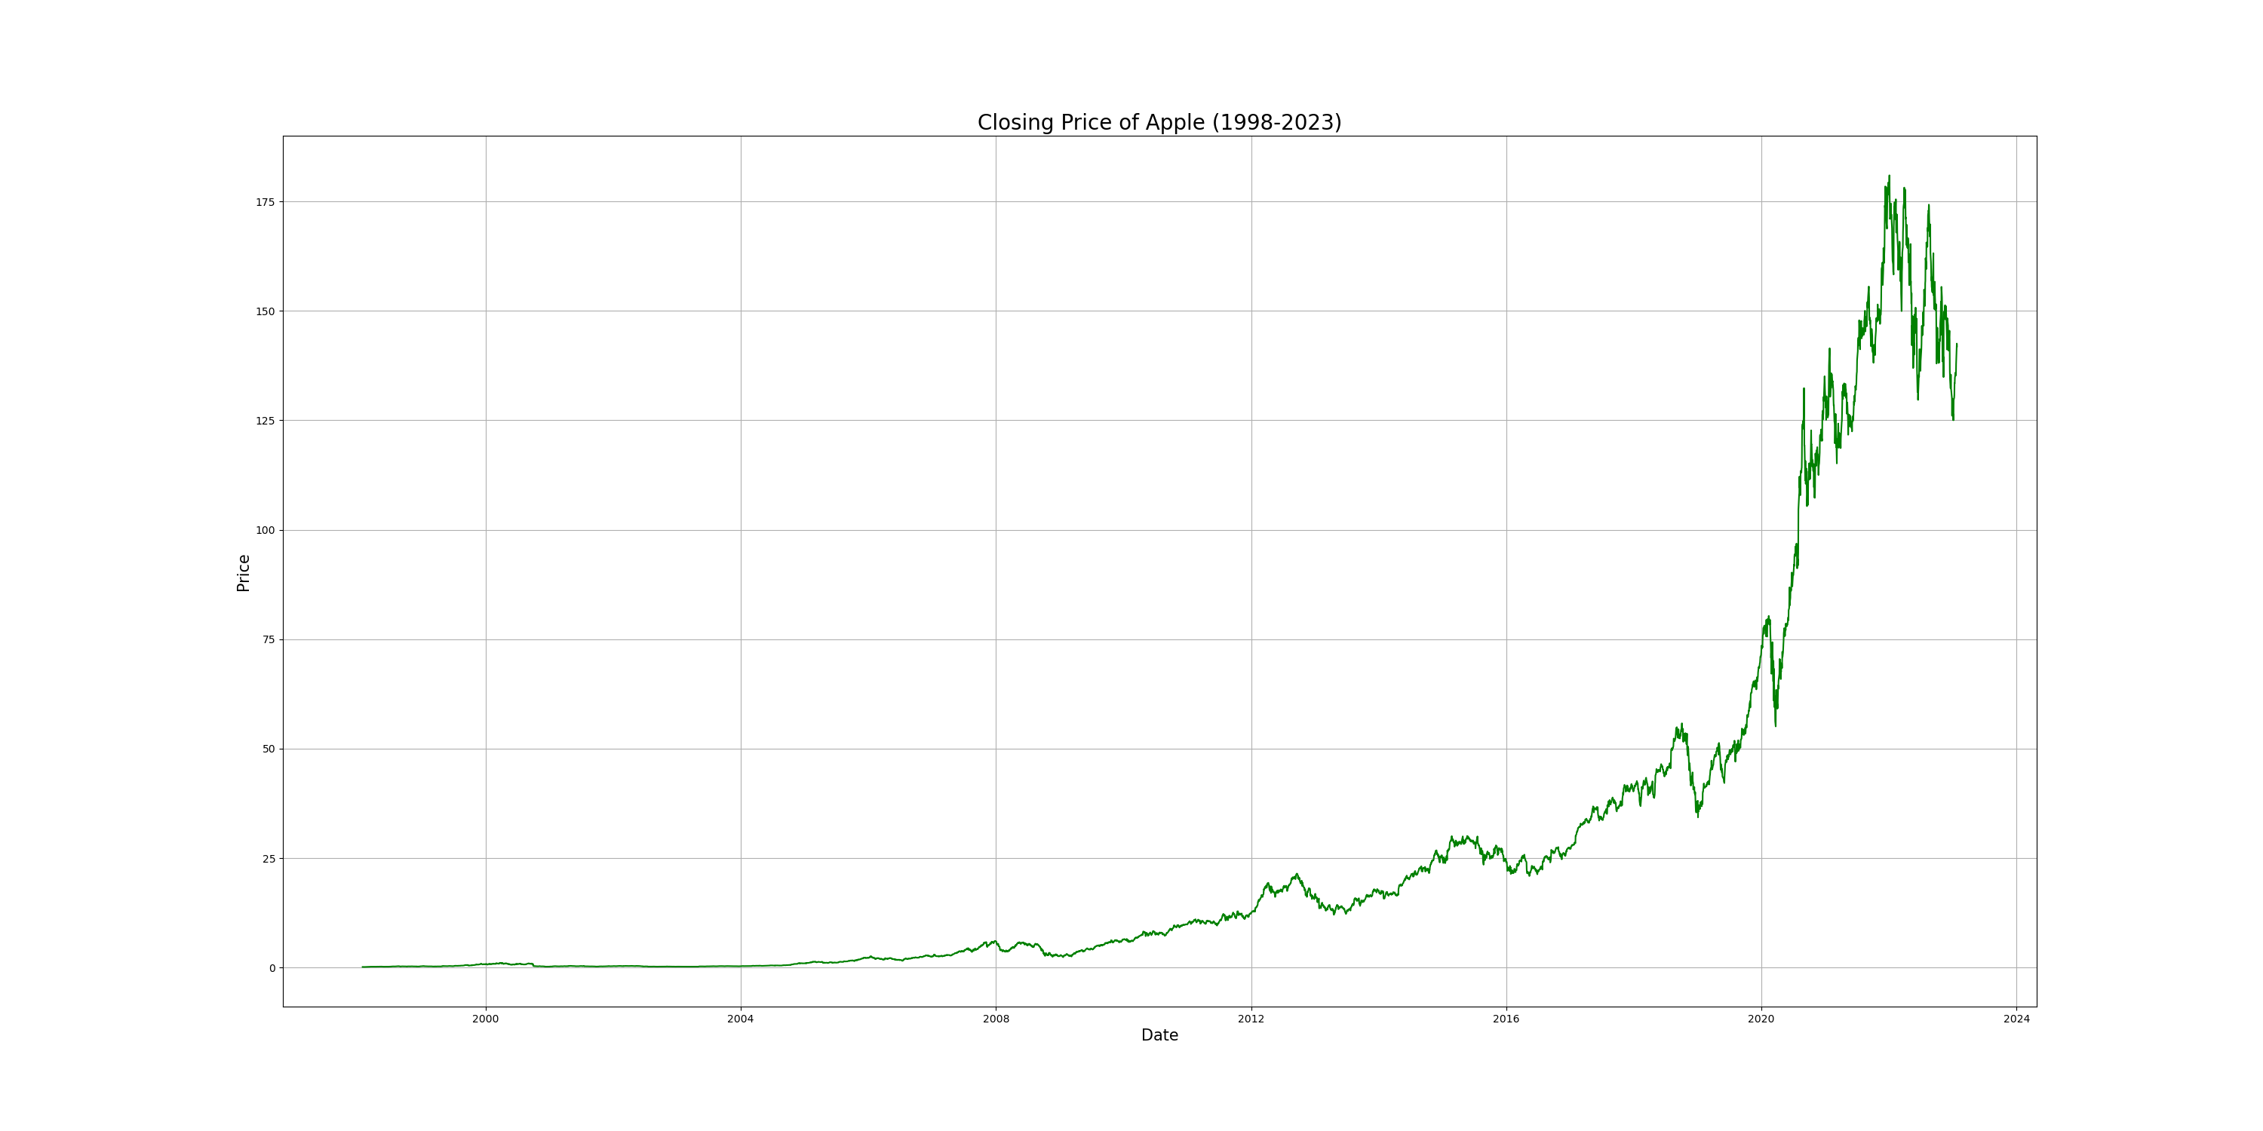

Slide 9
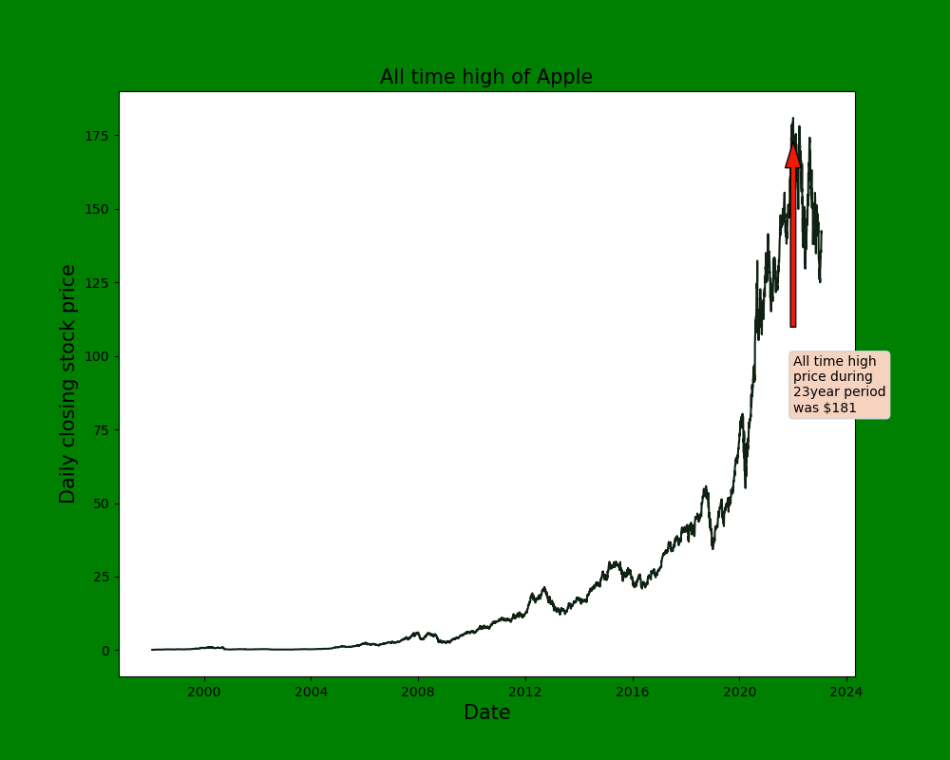

Slide 10
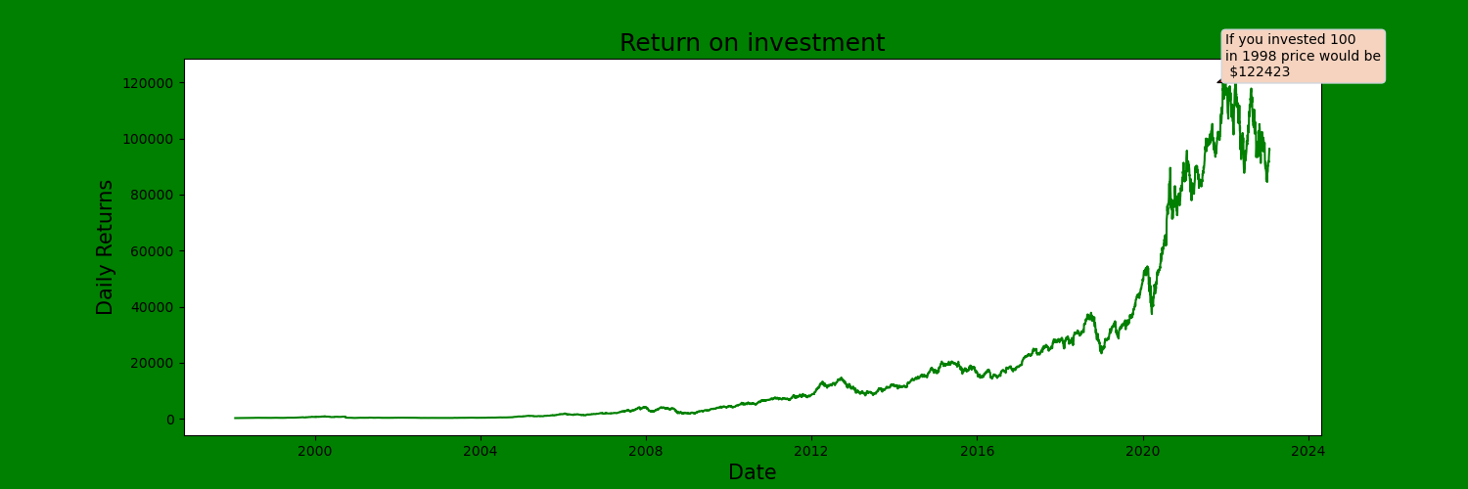

Slide 11
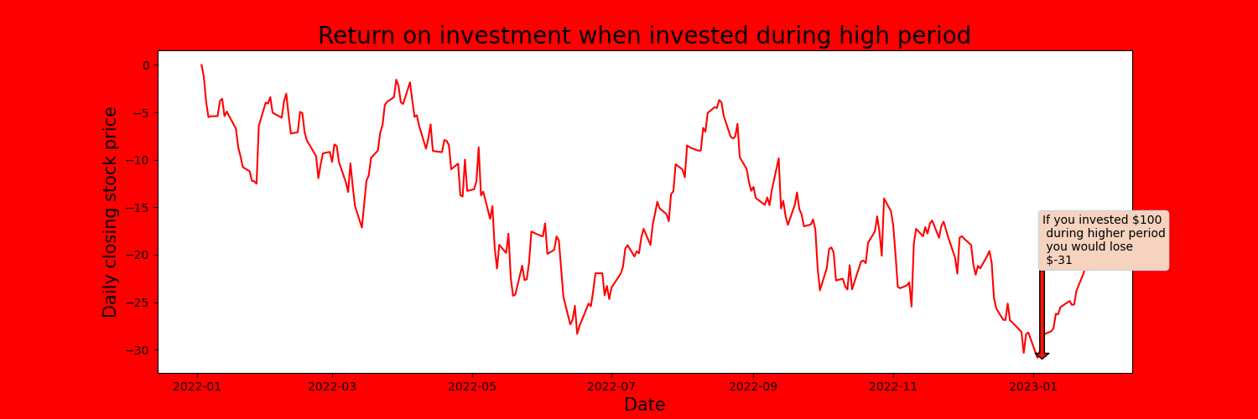

Slide 12

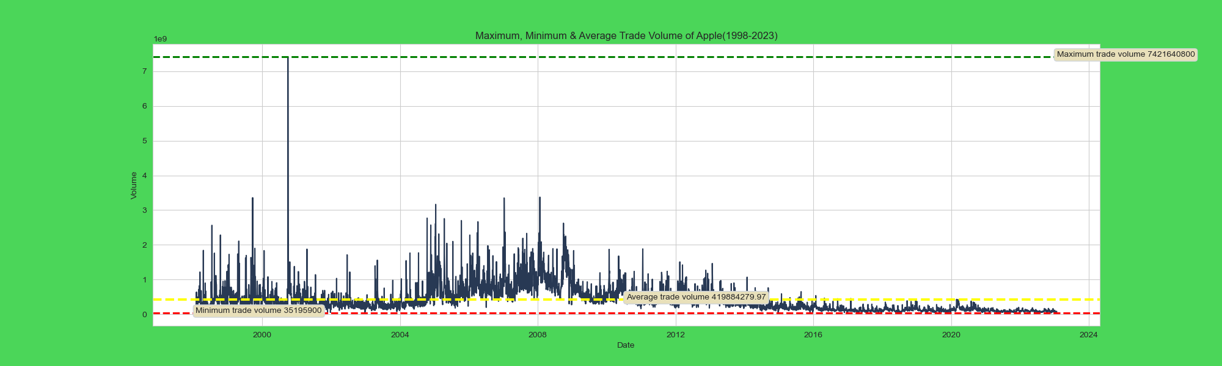

Slide 13
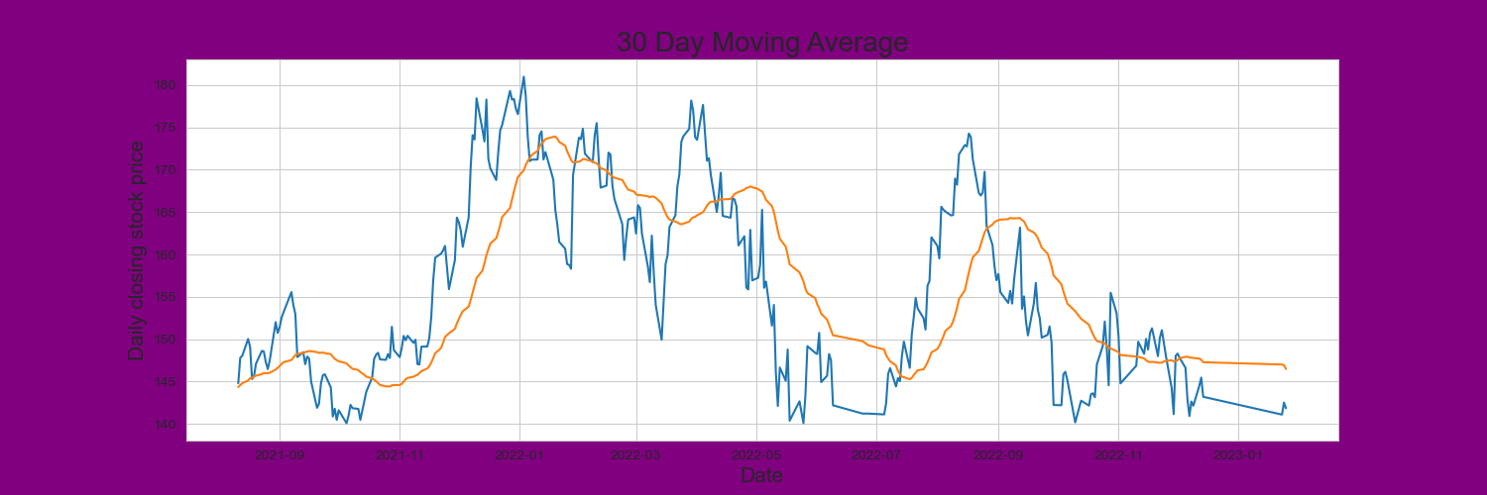

Slide 14


Score-97.79% R square- 0.99 MSE- 3.80
Linear Regression

Slide 15
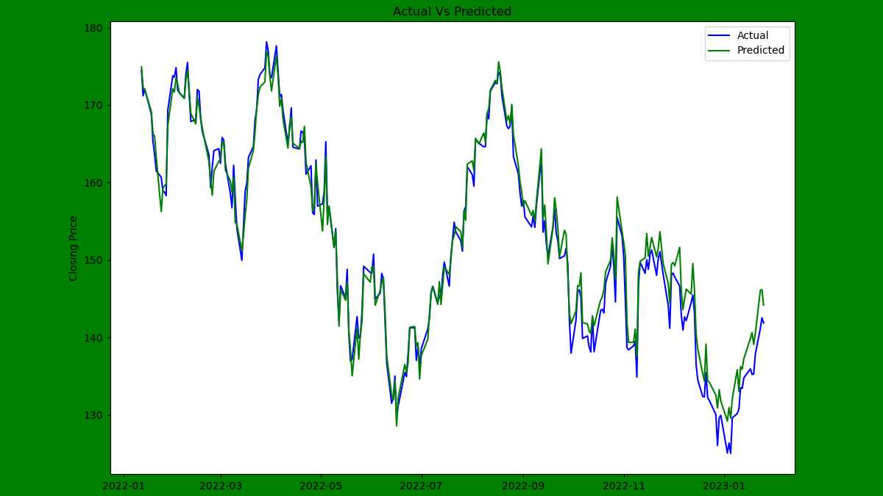

Slide 16
Assumptions of Linear Regression
Drawbacks of 1st Model
linear relationship between target and predictors
relationship between target and predictors constant over time
Its not linear
Its not constant
Highly co-related

Slide 17

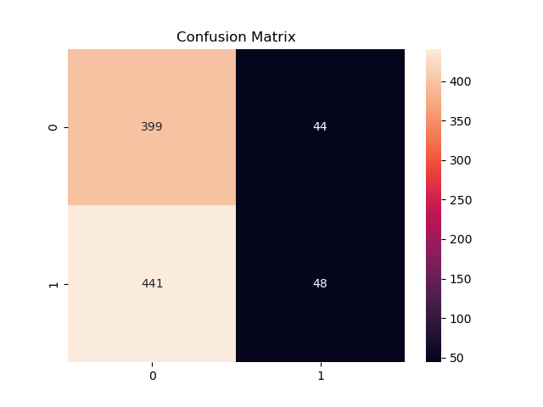
Random Forest Classifier
Accuracy:47.96%

Slide 18
ARIMA Model
AR- Uses its own lags as predictors.
I- Integrated
MA= lagged forecast

Slide 19
Stationarity Test
Augmented Dickey Fuller Test(ADF test)
Null hypothesis: Time Series is not stationary.
If p-value>0.05 we accept null hypothesis and infer time series is not stationary.
Order of Differencing
p-value=0.113

Slide 20
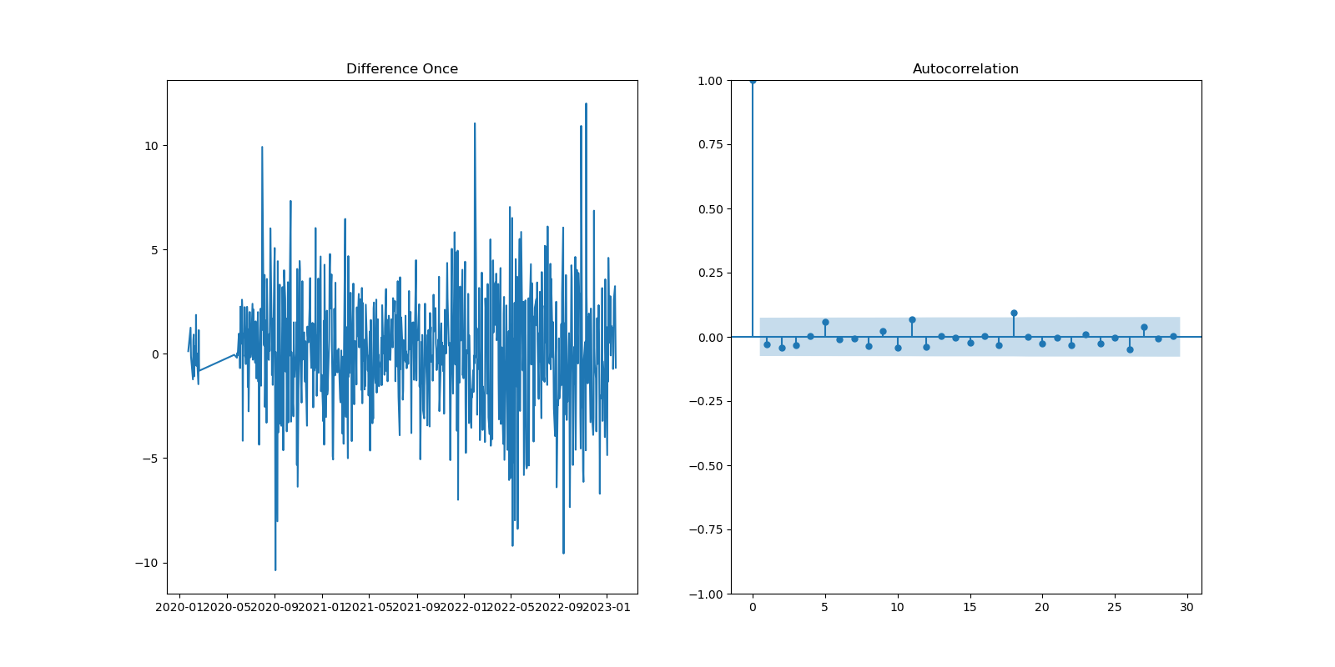
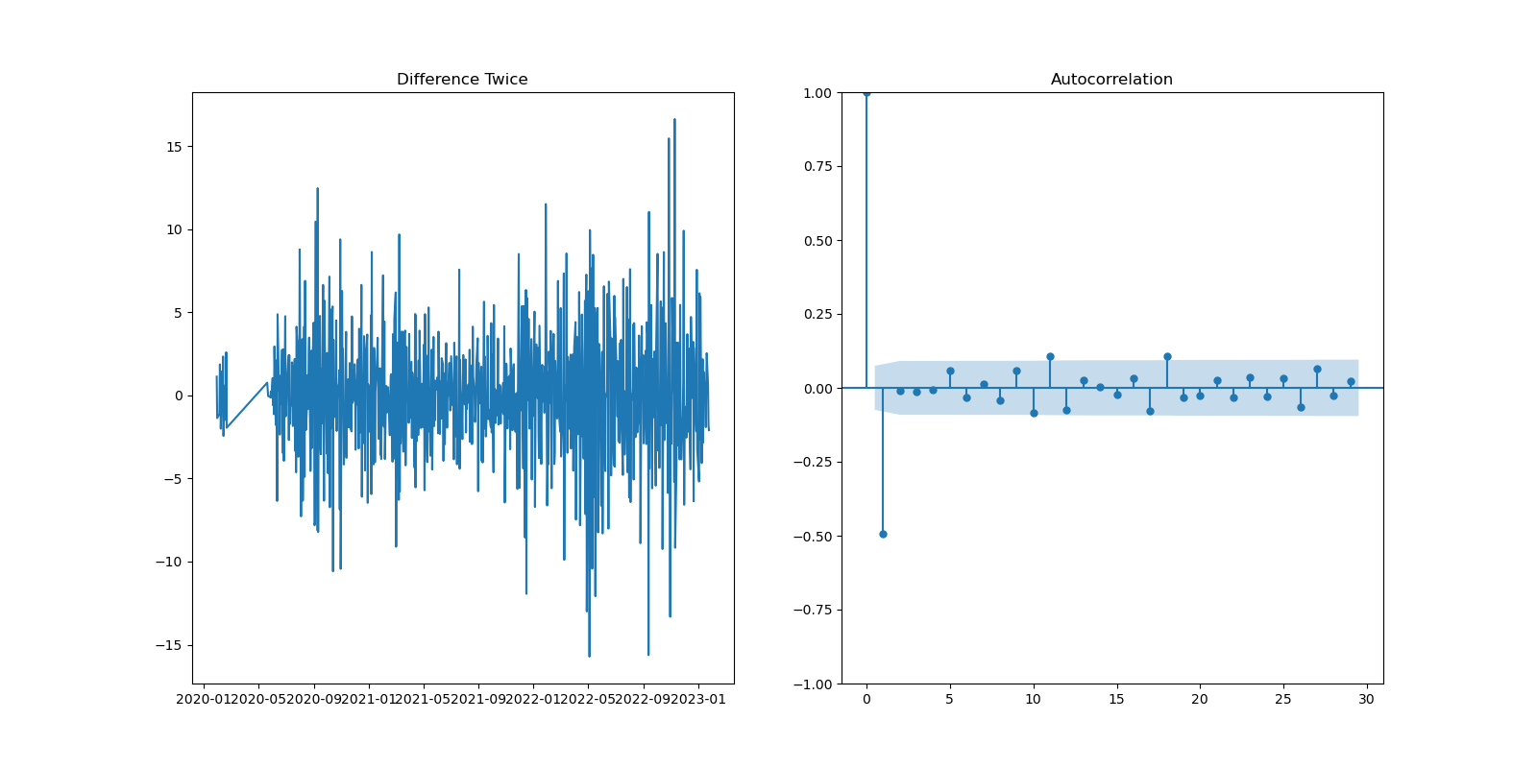
Order Of Differencing

Slide 21

PACF plot(p)

Slide 22
ACF plot (q)

Slide 23
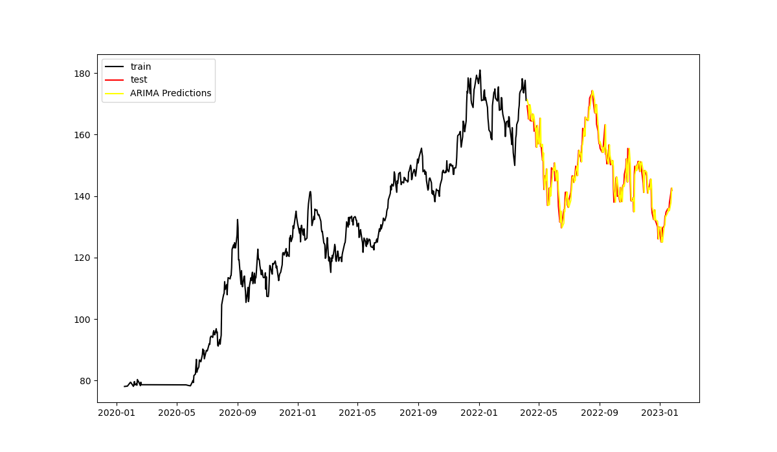
Actual Vs Predicted
RMSE: 3.42
MAPE: 1.78%

Slide 24
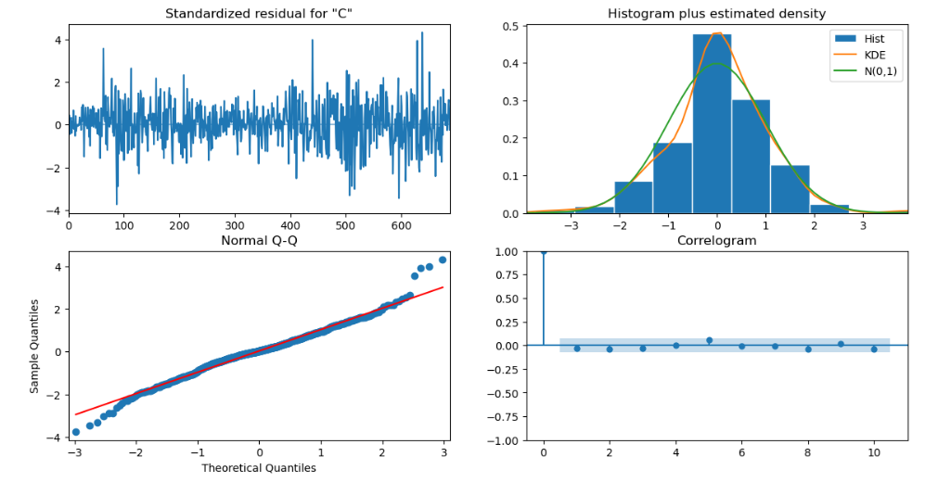

Slide 25
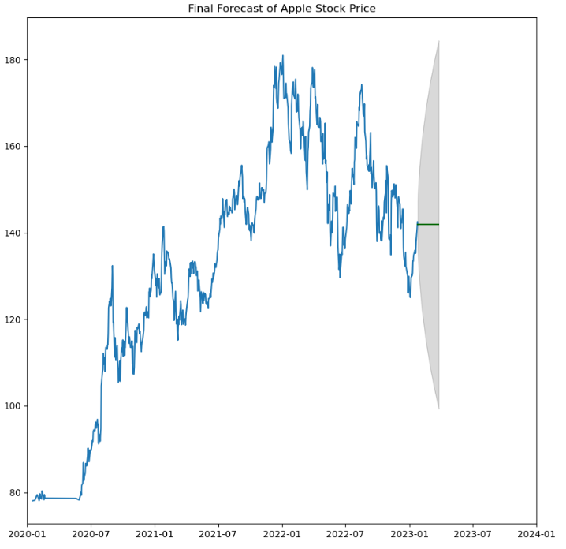
Forecasted

Slide 26

Conclusion & Future improvements
Conclusion:
Model predicted well but cannot implement at this stage.
Only looking at the Close price might not get a better results.
Future Improvements:
Add on more features.
Select neural network model for better prediction.

Slide 27


